Slide 1
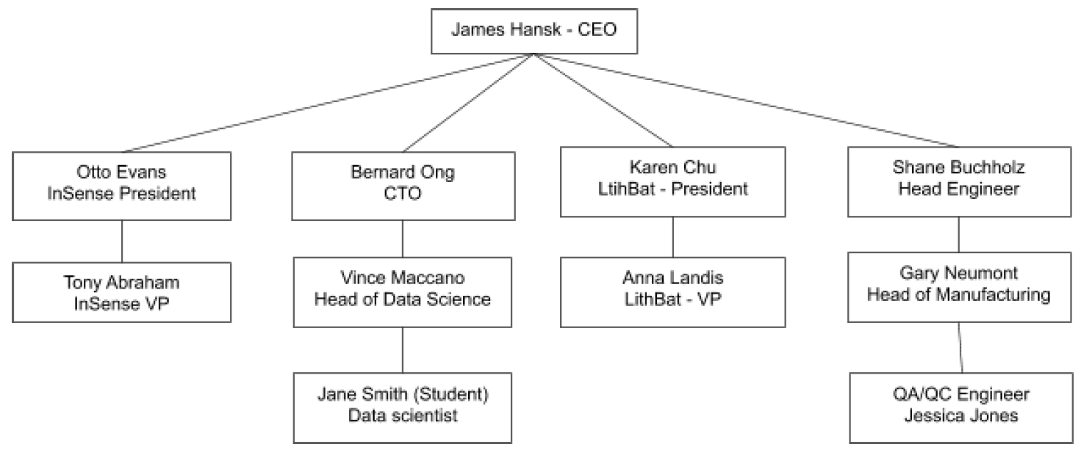
Problem Statement Worksheet (Hypothesis Formation)
What are the possible factors (manufacturers, parts suppliers, factory, or manufacture process or combination of factors) that lead to failures in NSC’s newest sensor, and how can Nordic Sensing Co. reduce sensor’s failures rate below 5%?
H
1
Context
4
Constraints within solution space
Nordic Sensor Company, a top-five player in the *IoT sensor space focusing on energy consumption and production, is dealing with a spike in InSense sensor failures (15% failure rate) during the final stage of testing before shipping. InSense is NSC’s newest offering in the residential energy usage space and already it is in huge demand, has been ordered in advance in large quantities and can be very fast manufactured. There are multiple suppliers of seven sensor parts, from different manufacturers, There are several manufacturing lines and factories producing this sensor. Therefore it’s crucial to locate factors immediately before manufacture continues.
- The data that is available is limited to 20K rows of data (covering back the two quarters)
5
Stakeholders to provide key insight
2
Criteria for success
Clear presentation of the possible causes for InSense failure spike.
Also pointing out which combination of faulty parts and poor manufacturing processes should be avoided to reach failure rate of 5%
3
Scope of solution space
6
Key data sources
- We will be focusing only on InSense failures, during last two quarters of manufacturing.
Excel format data extracted from Cert system - The data covers manufacturing dates with dated results for testing as well parts, suppliers and manufacturer to each sensor.
*Internet of Things
H
D
E
I
P
Notes:
Hypothesis: Create a Hypothesis with an emphasis on SMART principles. (S – Specific, M – Measurable, A – Achievable, R – Realistic, T – Timebound). If you cannot do this, you do not have a good grasp on the business problem.
Context: With context, we have clearly identified the problem at hand and have elucidated on how our initiative may solve this problem, alongside the commercial implications this will have on the business.
Criteria for Success: Clearly defining the criteria for success ensures that the scope of your work is clearly defined and understood. Otherwise, if this isn’t defined – your work will never end which will result in mismatched expectations.
Scope of Solution Space: Scoping out the solution space ensures that the business initiative is SPECIFIC for a certain segment or area. This prevents solutions that have been developed being scaled and applied for all other business units that the solution may not be responsible or scalable for.
Constraints within Solution Space: Looking forward, what are the foreseeable problems we are likely to encounter? Could this be stakeholder resistance? Could this be we don’t have access to the right data?
Stakeholders to provide key insight: Who are the people I need to speak to, to get the answers I need for my data analysis?
What key data sources are required?
Based off my discussions with the key stakeholders – can we clearly list out all the data sources we need so we can make a highly targeted request as opposed to a scatter-gun approach where we ask for a bit of everything?

